Slide 1

ASTRALLY

Slide 2

Intro
Astrally specializes in full-stack data migration, analytics, and SMS marketing consulting services, enabling businesses to harness cloud technologies and advanced data analytics to achieve their goals. Our team is dedicated to excellence, working closely with clients from concept to implementation to ensure superior craftsmanship and innovative solutions. Whether you're seeking to create a cozy retreat, a functional workspace, or a stunning commercial showcase, we are here to turn your aspirations into reality. Experience the difference of tailored IT solutions and sophisticated innovation with Astrally.

Slide 3
Phase 1:
Research and Analysis DRAFT

Slide 4
1. Market Research
Industry Trends
Growing demand for IT consulting in data management and IT infrastructure due to increased digital transformation initiatives (Gartner, 2023).
Rapid expansion of cloud computing and cybersecurity solutions (Statista, 2023).
Rising importance of technology staffing with an emphasis on remote work, contract staffing, and AI-driven recruitment (IBISWorld, 2023).
Increasing adoption of technology products such as project management tools and SMS marketing solutions (G2, 2023).
Integration of AI and automation in IT services and staffing processes (Forbes, 2023).

Slide 5
1. Market Research
Customer Behavior
Enterprises are shifting towards data-driven decision-making, requiring advanced IT consulting (Crunchbase, 2023).
Businesses prefer scalable and cost-effective staffing solutions (Clutch, 2023).
SMBs and enterprises seek integrated project management tools to streamline operations (Goodfirms, 2023).
Preference for AI-powered recruitment platforms that enhance hiring efficiency (TechCrunch, 2023).
Growth in mobile-based marketing, increasing demand for SMS marketing solutions (Business Insider, 2023).

Slide 6
2. Competitor Analysis (SWOT)
Small Business Competitors
TechNova Solutions (IT Consulting & Staffing) (Owler, 2023).
HireTech Hub (Technology Staffing) (ZoomInfo, 2023).
TaskFlow Apps (Technology Products - Project Management) (G2, 2023).
SMS Connect Pro (SMS Marketing Solutions) (Clutch, 2023).
Revenue Insights
TechNova Solutions (2023): Estimated $5-10 million (Owler, 2023).
HireTech Hub (2023): Estimated $3-8 million (ZoomInfo, 2023).
TaskFlow Apps (2023): Estimated $2-6 million (G2, 2023).
SMS Connect Pro (2023): Estimated $1-5 million (Clutch, 2023).

Slide 7
SWOT Analysis
2. Competitor Analysis (SWOT)
Factor | Strengths | Weaknesses | Opportunities | Threats
TechNova Solutions | Personalized service, niche expertise | Limited brand recognition | Growing demand for specialized IT consulting | Larger firms offering competitive pricing (ZoomInfo, 2023)
HireTech Hub | Specialized tech staffing, quick hiring process | Limited global reach | Expansion in remote and contract-based hiring | High competition from other small agencies (Crunchbase, 2023)
TaskFlow Apps | Affordable, user-friendly project management tools | Fewer advanced features | Increasing adoption by startups & SMBs | Competition from freemium tools (G2, 2023)
SMS Connect Pro | Cost-effective, easy-to-use platform | Limited enterprise features | Growing demand for SMS marketing | Compliance and regulatory challenges (Business Insider, 2023)

Slide 8
3. Target Audience
Primary Target Audience
Startups & SMBs in need of IT consulting for data management & IT infrastructure.
HR & Hiring Managers seeking technology staffing solutions.
Project Managers & Small Business Owners requiring project management tools.
Local Businesses & SMEs looking for SMS marketing solutions.

Slide 9
4. Customer Personas
1. Startup Founder (SMB & Enterprise Clients)
Pain Points: Limited IT resources, need for cost-effective solutions.
Solution: IT consulting for efficient data management & IT infrastructure.
Preferred Channels: LinkedIn, industry events, startup forums (Gartner, 2023).
2. HR Manager (Technology Staffing Clients)
Pain Points: Struggling to find specialized tech talent, long hiring cycles.
Solution: AI-powered staffing solutions, contract & full-time tech hiring.
Preferred Channels: Job portals, LinkedIn, HR networking events (Clutch, 2023).

Slide 10
4. Customer Personas
3. Startup Project Manager (Technology Product Users)
Pain Points: Need for simple, affordable project management tools.
Solution: Project management apps with cost-effective pricing.
Preferred Channels: Software review platforms, LinkedIn ads, startup incubators. (G2, 2023).
4. Local Business Owner (SMS Marketing Clients)
Pain Points: Struggling with customer engagement & low marketing ROI.
Solution: Automated SMS marketing solutions tailored for small businesses.
Preferred Channels: Local business groups, digital marketing blogs, email campaigns. (Business Insider, 2023).

Slide 11
References
Gartner. (2023). IT Consulting Market Trends. Retrieved from https://www.gartner.com
Statista. (2023). Cloud Computing & Cybersecurity Growth. Retrieved from https://www.statista.com
IBISWorld. (2023). Technology Staffing Industry Report. Retrieved from https://www.ibisworld.com
G2. (2023). Project Management Tools Market Overview. Retrieved from https://www.g2.com
Forbes. (2023). AI in IT Services & Staffing. Retrieved from https://www.forbes.com
Crunchbase. (2023). Tech Startup Industry Insights. Retrieved from https://www.crunchbase.com
Clutch. (2023). IT Services & Staffing Company Ratings. Retrieved from https://www.clutch.co
GoodFirms. (2023). SMB Adoption of Project Management Tools. Retrieved from https://www.goodfirms.co
TechCrunch. (2023). AI in Recruitment & Hiring. Retrieved from https://www.techcrunch.com
Business Insider. (2023). Growth of SMS Marketing. Retrieved from https://www.businessinsider.com
Owler. (2023). TechNova Solutions Revenue Data. Retrieved from https://www.owler.com
ZoomInfo. (2023). HireTech Hub Market Insights. Retrieved from https://www.zoominfo.com

Slide 12
Phase 2:
Strategy Development

Slide 13
📊 Strategy Development for Astrally
🎯 UNIQUE VALUE PROPOSITION
🔄 End-to-End Integration: Seamless IT, marketing & data solutions
💡 Innovation-Driven: Cutting-edge technology implementation
📈 Scalable Solutions: Growth-aligned technology
🎯 Industry Focused: Deep vertical expertise
🤝 Partnership Approach: Long-term client success

Slide 14
🌟 BRAND POSITIONING
🏢 Target Market: SMB and mid-market enterprises
💪 Market Position: Premium full-service technology partner
🎯 Core Focus: Digital transformation enabler
🌐 Coverage: Multi-industry expertise
✨ Differentiation: Integrated solutions provider(PERSONALISED custormer relationship)

Slide 15
📣 KEY BRAND MESSAGING
🎯 Primary Message:
"Technology solutions that evolve with your business"
💬 Supporting Messages:
🔧 "Expert solutions, seamless integration"
🚀 "Accelerating business growth through technology"
💡 "Innovation meets industry expertise"

Slide 16
🎯 GO-TO-MARKET STRATEGY
Phase 1: Foundation (Q1-Q2 2024)
Objective: Establish market presence and core capabilities
🚀 Launch core services: Start with most in-demand services
🌐 Establish digital presence: Website, social media, content strategy
👥 Build initial sales team: Industry-specialized account executives
🤝 Develop partner network: Technology vendors and service providers

Slide 17
Phase 2: Growth (Q3-Q4 2024) Objective: Expand market reach and service depth
📈 Scale service portfolio: Add specialized offerings
📣 Expand marketing operations: Content marketing and thought leadership
⚡ Enhance delivery capabilities: Standardize processes for efficiency
❤️ Launch client success program: Proactive support and optimization

Slide 18
Phase 3: Scale (2025) Objective: Market leadership and expansion
🌍 Geographic expansion: Move into new regions
🎯 New vertical penetration: Expand industry focus
💡 Advanced solution development: Develop proprietary tools
🤝 Strategic partnerships: Strategic alliances for growth

Slide 19
🎯 TARGET SEGMENTS
📈 Growth-stage businesses (10-100 employees): Focus on fundamental digital transformation
🏢 Mid-market companies (100-500 employees): Complex integration and scaling solutions
Key Verticals: (Each chosen for growth potential and technology needs)
🛍️ Retail/E-commerce: Focus on omnichannel presence
🏥 Healthcare: Emphasis on secure data management
💼 Professional Services: Automation and client management
💰 Financial Services: Compliance and security-first approach

Slide 20
💰 REVENUE MODEL & PRICING STRATEGY
🔄 SERVICE MIX BREAKDOWN
📊 IT Consulting: 40%
Enterprise architecture planning
Cloud migration services
Security implementations
Digital transformation projects Why This Mix? Highest value service with strong market demand and established pricing models

Slide 21
📱 SMS Marketing: 30%
Campaign management
Automation solutions
Analytics & reporting
Customer engagement Why This Mix? Growing market with recurring revenue potential and scalable delivery model

Slide 22
📈 Data Analytics: 30%
Business intelligence
Predictive analytics
Data visualization
Custom reporting Why This Mix? High-growth area with strong upsell potential and strategic value

Slide 23
💼 PRICING MODELS
🏗️ Project-Based (35% of Revenue)
Range: $20K-$100K per project
Timeline: 2-6 months
Best for: Large implementations, migrations, transformations Why This Model? Allows for high-value, complex deliverables with clear scope and milestones

Slide 24
🔄 Retainer-Based (50% of Revenue)
Monthly Fee: $3K-$15K
Contract Length: 12-36 months
Best for: Ongoing support, maintenance, and continuous improvement Why This Model? Provides stable, predictable revenue stream and deeper client relationships

Slide 25
⭐ Performance-Based (15% of Revenue)
Structure: Base fee + performance incentives
Focus: Marketing and analytics services
Best for: Results-driven campaigns and optimization projects Why This Model? Aligns interests with clients and demonstrates confidence in service quality

Slide 26
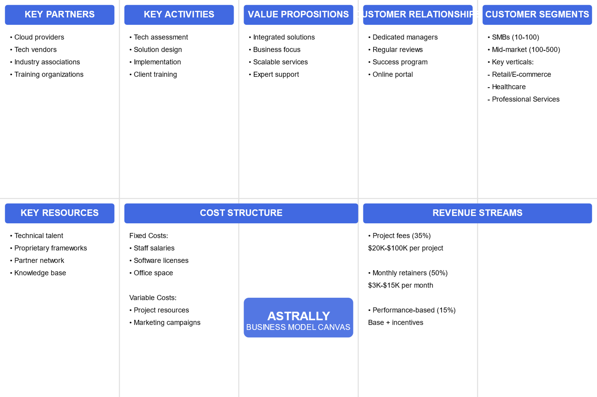

Slide 27
Phase 3:
Marketing Plan & Execution Framework

Slide 28
1. Digital Marketing Strategy
Content Marketing
Develop thought leadership content (whitepapers, case studies, blogs) targeting IT consulting, staffing, and technology products.
Create industry-specific reports to showcase expertise and insights.
Leverage SEO-optimized website content to improve organic reach.
Social Media Marketing
Establish a presence on LinkedIn, Twitter, and YouTube to engage industry professionals.
Implement a content calendar with weekly posts, including tech trends, company updates, and customer success stories.
Use LinkedIn and Twitter Ads to target SMB decision-makers and HR professionals.

Slide 29
1. Digital Marketing Strategy
Email Marketing
Develop segmented email campaigns for different audience personas.
Implement drip campaigns for nurturing leads and educating prospects.
Offer exclusive webinars and case studies to encourage engagement.
Influencer & Partner Marketing
Collaborate with industry influencers and IT professionals to amplify brand awareness.
Partner with tech communities, incubators, and online forums to position Astrally as a thought leader.

Slide 30
2. Paid Advertising Strategy
Google Ads & Search Engine Marketing (SEM)
Target keywords related to IT consulting, tech staffing, and business project management tools.
Run PPC campaigns optimized for conversions and lead generation.
Social Media Advertising
Use Facebook, Instagram, and LinkedIn ads to promote case studies and webinars.
Implement retargeting campaigns to capture leads who engaged with website content.
Display & Video Advertising
Run YouTube ads showcasing Astrally’s services and success stories.
Use banner ads on tech-focused platforms (e.g., TechCrunch, Clutch, and G2).

Slide 31
3. Partnership & Collaboration Strategy
Identify and collaborate with complementary businesses (e.g., cloud service providers, HR tech firms) for joint webinars and co-marketing campaigns.
Form strategic alliances with recruitment platforms and IT consulting networks.
Offer referral programs with incentives for customers and industry partners.

Slide 32
Competitor Analysis & Marketing Budgets for Astrally
1. Similar Companies in the Market
Astrally operates in the IT consulting, data analytics, and SMS marketing space. Some similar companies in this market include:
Data BI LLC - Specializes in business intelligence and data analytics.
Deloitte Consulting - Provides IT consulting and marketing analytics.
RevOps Global - Focuses on sales and marketing revenue optimization.
Direct Online Marketing - Digital marketing services with data-driven strategies.

Slide 33
Competitor Analysis & Marketing Budgets for Astrally
2. Marketing Budgets of Similar Companies
General Marketing Budget Allocation:
SMBs allocate 7-8% of annual revenue to marketing.
B2C companies may spend between 5-10%, or up to 15%, while B2B firms allocate around 5%.
Monthly Marketing Spend:
Small to mid-sized businesses invest between $2,500 and $12,000 in digital marketing (WebFX).
This budget includes SEO, paid advertising (PPC), social media, email marketing, and content creation.

Slide 34
Competitor Analysis & Marketing Budgets for Astrally
3. Key Takeaways:
Competitors: Astrally competes with firms like Data BI LLC, Deloitte Consulting, and RevOps
Global.
Marketing Investment:
SMBs dedicate 7-8% of revenue to marketing.
B2C firms invest up to 14%, while B2B firms allocate around 5%.
Monthly budgets range from $2,500 to $12,000, covering digital strategies.
Marketing Channels: Digital marketing strategies include SEO, PPC, social media, email marketing, and influencer collaborations.

Slide 35
Marketing Budgets
Budget Category | SMBs | Medium Scale (e.g. B2C companies) | Large Scale (e.g. B2B companies)
General Marketing Budget | 7-8% of annual revenue | Up to 14% of annual revenue | Around 5% of annual revenue
Monthly Marketing Spend | $2,500 - $12,000 | Not specified | Not specified
Budget Includes | SEO, PPC, social media, email marketing, content creation | SEO, PPC, social media, email marketing, content creation
Reference Companies | ? | ? | ?
SEO, PPC, social media, email marketing, content creation

Slide 36
References:
Data BI LLC - https://clutch.co/it-services/analytics/wyoming
Deloitte Consulting - https://www.g2.com/products/nielsen-marketing-mix-modeling/competitors/alternatives
RevOps Global - https://www.g2.com/products/nielsen-marketing-mix-modeling/competitors/alternatives
Direct Online Marketing - https://www.g2.com/products/nielsen-marketing-mix-modeling/competitors/alternatives
Marketing Budget Allocations - https://falia.co/en/ressources/what-marketing-budget-for-a-small-or-medium-sized-6. Monthly Marketing Spend - https://www.webfx.com/industries/general/small-businesses/marketing-budget/

Slide 37
Phase 4:
Implementation Roadmap

Slide 38
Step-by-Step Execution Roadmap with Timelines
Launch & Awareness (Jun- Aug 2025)
Finalize brand positioning and messaging.
Develop and launch an SEO-optimized website.
Establish social media presence on LinkedIn, Twitter, and YouTube.
Initiate a content strategy including blogs, case studies, and whitepapers.
Implement Google Ads and LinkedIn Ads campaigns.

Slide 39
Step-by-Step Execution Roadmap with Timelines
Lead Generation & Engagement (Aug- Oct 2025)
Run targeted email marketing campaigns.
Launch lead nurturing drip campaigns.
Collaborate with industry influencers and tech communities.
Conduct webinars and online events.
Monitor analytics and refine ad campaigns for optimization.

Slide 40
Step-by-Step Execution Roadmap with Timelines
Expansion & Optimization (Oct - Dec 2025)
Scale content marketing efforts with deeper industry insights.
Optimize PPC and SEM campaigns based on data-driven insights.
Strengthen referral and partnership programs.
Launch retargeting ad campaigns.
Expand social media engagement with interactive content.

Slide 41
Step-by-Step Execution Roadmap with Timelines
Scaling & Market Leadership (Dec 2025- Feb 2026)
Implement advanced analytics and marketing automation tools.
Explore expansion into new target industries.
Develop proprietary industry reports to establish market credibility.
Conduct customer satisfaction analysis and feedback collection.
Plan for the 2026 growth strategy.

Slide 42
Recommended Tools & Platforms
Marketing Automation & CRM
HubSpot – Lead management, email marketing, and customer tracking.
Marketo – Advanced B2B marketing automation.
Zoho CRM – Affordable CRM with automation features.
Social Media & Advertising
LinkedIn Ads & Campaign Manager – Target B2B decision-makers.
Google Ads & SEMRush – PPC and search engine marketing.
Hootsuite / Buffer – Social media scheduling and automation.

Slide 43
Recommended Tools & Platforms
Analytics & SEO Optimization
Google Analytics & Search Console – Website traffic and SEO tracking.
SEMRush / Ahrefs – Keyword research and competitor analysis.
Hotjar – User behavior analytics for website performance.

Slide 44
Roles & Responsibilities for Marketing Execution
Marketing Manager
Oversee overall marketing strategy and execution.
Coordinate teams and ensure timely implementation.
Content Strategist
Develop and manage content strategy including blogs, case studies, and reports.
Optimize content for SEO and lead generation.
Social Media Manager
Manage engagement on LinkedIn, Twitter, and YouTube.
Execute social media advertising campaigns and monitor performance.

Slide 45
Roles & Responsibilities for Marketing Execution
Paid Advertising Specialist
Run and optimize Google Ads and PPC campaigns.
Manage SEM strategies and retargeting efforts.
Marketing Analyst
Track campaign performance using analytics tools.
Provide insights for continuous strategy adjustments.
Partnership Manager
Identify and develop strategic partnerships.
Manage influencer collaborations and referral marketing programs.

Slide 46
References
Market Trends & Digital Strategy
Gartner. (2023). IT Consulting Market Trends. Retrieved from https://www.gartner.com
IBISWorld. (2023). Technology Staffing Industry Report. Retrieved from https://www.ibisworld.com
Business Insider. (2023). Growth of SMS Marketing. Retrieved from https://www.businessinsider.com
Marketing Automation & SEO Optimization
HubSpot. (2024). Why Businesses Choose HubSpot for Lead Management. Retrieved from https://www.hubspot.com
Google Search Console. (2024). Improving Website Performance Using Google Search Console. Retrieved from https://search.google.com/search-console
SEMRush. (2024). The Role of SEM & PPC in Business Growth. Retrieved from https://www.semrush.com
Social Media Listening & Engagement
Brandwatch. (2024). Social Media Listening for Brand Monitoring. Retrieved from https://www.brandwatch.com
Sprout Social. (2024). The Power of Social Media Engagement. Retrieved from https://sproutsocial.com

Slide 47
Project Recap (Phase 1-4)

Slide 48
Phase 5:
Performance Measurement & Optimization
This phase is all about proving the effectiveness of Astrally’s marketing strategy and continuously improving it using real-time data. It ensures that Astrally’s marketing efforts are measurable, scalable, and adaptable to changing business needs.

Slide 49
Define Key Performance Indicators (KPIs)
KPIs are metrics that help evaluate success across all marketing channels. Astrally’s KPIs should be SMART (Specific, Measurable, Achievable, Relevant, Time-bound).
• Website Visitors – Total number of users visiting the website during the month (tracked via Google Analytics).
• Conversion Rate – Percentage of visitors converting into leads. Formula: (Leads / Visitors) * 100.
• Cost per Lead – Marketing spend divided by the number of leads generated.
• Email Open & Click Rates – Measured from email campaign platforms like HubSpot or Zoho.
• Return on Ad Spend (ROAS) – Revenue generated per dollar spent on ads.
• Social Media Engagement – Includes likes, shares, comments, and reach.

Slide 50
Develop a Marketing ROI Framework
Recommendations for Optimization & Scaling
Formula: Marketing ROI = (Revenue from Campaign - Marketing Cost) / Marketing Cost × 100
Advanced attribution models such as first-touch, last-touch, and time-decay can be used to assign credit across the marketing funnel for a more accurate ROI.
• A/B Testing – Run experiments on ads, emails, and landing pages.
• Budget Reallocation – Focus on high-performing channels and pause low-performing ones.
• SEO Improvements – Improve keywords, site speed, and metadata.
• Content Strategy – Refresh underperforming blogs and scale high-value assets.
• Audience Refinement – Use analytics data to improve targeting.
• Automation – Implement tools for email workflows and ad scheduling.

Slide 51
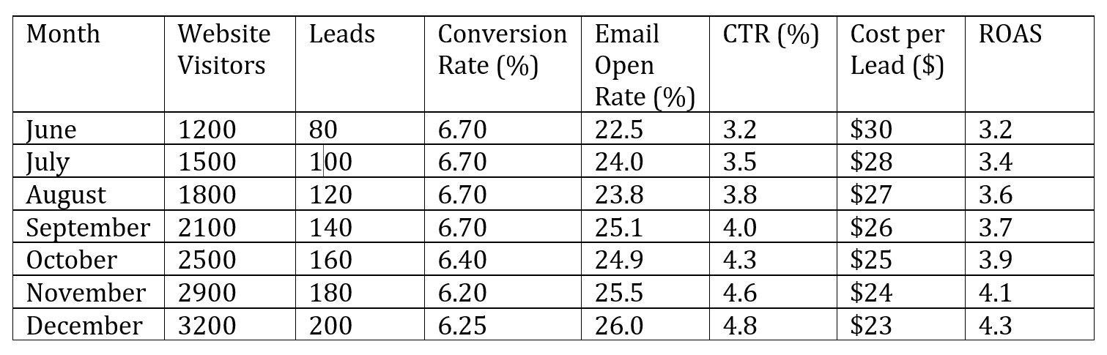
Monthly Marketing Dashboard Summary
This section provides a month-by-month breakdown of Astrally’s marketing performance metrics.

Slide 52
Insights & Recommendations
- Website traffic steadily increased from 1,200 in June to 3,200 in December.
- Lead generation improved in proportion, maintaining an average conversion rate of 6.7%.
- Email open rates rose to 26%, indicating successful subject line and audience targeting.
- Cost per lead dropped from $30 to $23, indicating improved ad efficiency.
- ROAS increased from 3.2 to 4.3, showing greater profitability in ad spend.

Slide 53
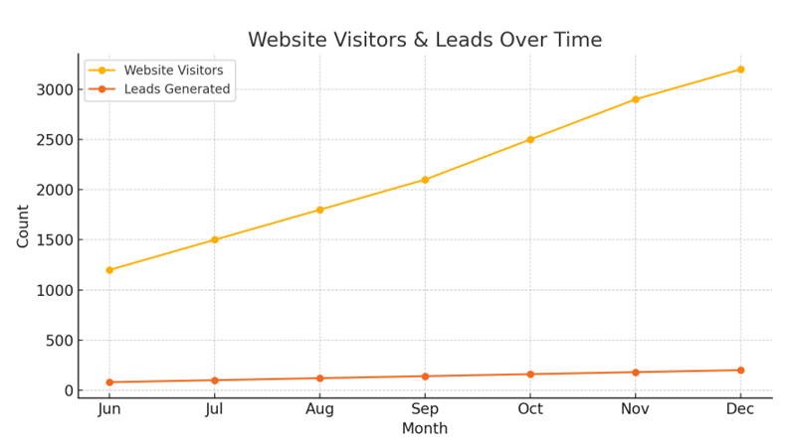
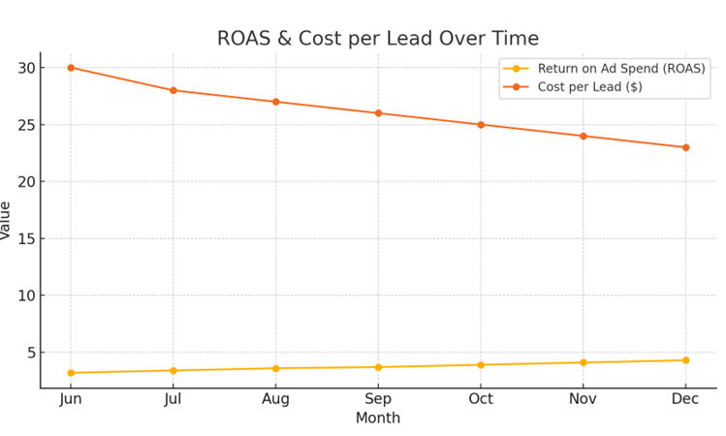
Visual Performance Charts
Website Visitors & Leads Over Time
Return on Ad Spend (ROAS) & Cost per Lead Over Time

Slide 54
Metric Calculations
• Website Visitors: No formula — Tracked via Google Analytics as total sessions.
• Leads Generated: No formula — Count of leads captured via forms or CRM.
• Conversion Rate (%): Conversion Rate = (Leads Generated / Website Visitors) * 100
• Email Open Rate (%): Open Rate = (Emails Opened / Emails Sent) * 100
• Click-Through Rate (CTR): CTR = (Ad Clicks / Ad Impressions) * 100
• Cost per Lead (USD): Cost per Lead = Total Ad Spend / Leads Generated
• Return on Ad Spend (ROAS): ROAS = Revenue from Ads / Total Ad Spend

Slide 55
Tools for Optimization, Scaling, and Social Media Engagement
Recommendations for Optimization & Scaling
A/B Testing: Google Optimize, Optimizely, VWO
Ad Budget Reallocation: Google Ads, LinkedIn Campaign Manager, Meta Ads Manager
SEO Improvements: SEMrush, Ahrefs, Google Search Console
Content Strategy Enhancement: BuzzSumo, Grammarly, Clearscope
Audience Refinement / Targeting: Meta Audience Insights, LinkedIn Ads Targeting, Google Analytics Audiences
Retargeting Campaigns: Google Ads Remarketing, Facebook Pixel, AdRoll
Email & Ad Automation: HubSpot Marketing Hub, Mailchimp, ActiveCampaign
Analytics & Performance Tracking: Google Analytics 4 (GA4), Looker Studio, Mixpanel
Lead Scoring / CRM: Zoho CRM, Salesforce, HubSpot CRM

Slide 56
Tools for Optimization, Scaling, and Social Media Engagement
Top Tools for Social Media Engagement
Hootsuite:
Why It's Great: Schedule posts, monitor engagement, and respond across multiple platforms.
Use Case Fit: Best for managing LinkedIn, Instagram, and Twitter in one place.
Buffer:
Why It's Great: Easy post scheduling, analytics, and collaboration features.
Use Case Fit: Ideal for analyzing B2B content performance with a lean team.
Sprout Social:
Why It's Great: Advanced analytics, smart inbox for all DMs, and audience insights.
Use Case Fit: Great for tracking engagement and making data-driven decisions.

Slide 57
LinkedIn Performance Metrics (Jun to Dec)
Month | LinkedIn Impressions | LinkedIn Clicks | LinkedIn CTR (%)
June | 2300 | 75 | 3.26%
July | 2800 | 100 | 3.57%
August | 3200 | 125 | 3.91%
September | 3700 | 150 | 4.05%
October | 4000 | 175 | 4.38%
November | 4500 | 200 | 4.44%
December | 5000 | 230 | 4.60%

